Slide 1

基于Microsoft Teams 构建应用集成和工作流 陈 希章 | 微软（亚洲）互联网工程院
实施 Microsoft 身份（一）
实施 Microsoft 身份（二）
Microsoft Graph 简介
扩展 Microsoft SharePoint
扩展 Microsoft Teams (一）
扩展 Microsoft Teams (二）

Slide 2
实施 Microsoft 身份（第 1 段，共 2 段）
Microsoft 身份验证入门
实施身份验证
权限和同意框架

Slide 3
Microsoft 身份验证入门
Microsoft 身份平台概述
Microsoft 身份中的令牌类型
注册应用
Notes:
In this section, you will learn the basics of Microsoft identity including the different types of tokens, account types, and supported topologies.

Slide 4
Microsoft 身份平台概述

Slide 5
为什么使用标识提供程序？
委托认证和授权可以实现以下场景:
要求用户位于特定地点的有条件访问策略
多因素认证的使用
单一登录 (SSO)
Azure Active Directory (Azure AD)：云中的集中式标识提供程序
Microsoft 身份平台： 身份即服务，支持行业标准协议，如 OAuth 2.0 以及 OpenID Connect + 开源代码库
Notes:
Instead of creating apps that each maintain their own username and password information, which incurs a high administrative burden when you need to add or remove users across multiple apps, apps can delegate authentication and authorization responsibilities to a centralized **identity provider**.
Authentication: proving identity.
Authorization: granting permission to an authenticated party.
Azure AD authenticates users and provides access tokens, which can be used to access Web APIs and other protected resources.
The Microsoft identity platform allows developers to build applications that sign in all Microsoft identities and get tokens to call Microsoft Graph, other Microsoft APIs, or APIs that developers have built.

Slide 6
Microsoft 身份平台概述
Microsoft 身份平台 (v. 2.0) 是 Azure Active Directory v1.0 (Azure AD) 开发人员平台的进化版本
Microsoft 身份平台包括：
符合 OAuth 2.0 和 OpenID Connect 标准的身份验证服务。
开源库
应用管理门户
应用配置 API 和 PowerShell
开发人员内容
Notes:
With the unified Microsoft identity platform (v2.0), you can write code once and authenticate any Microsoft identity into your application.
The Microsoft identity platform provides the following development experience:
**App registration experience:** The Azure portal App registrations experience is the one portal experience for managing all applications you’ve integrated with Microsoft identity platform. The Azure portal app registration should be used instead of the Application Registration Portal.
**Client SDK:** You can use the Microsoft Authentication Library (MSAL) to build applications that authenticate all Microsoft identities. MSAL is Microsoft’s latest identity platform solution and is preferred to ADAL.
**Endpoint:** Microsoft identity platform (v2.0) endpoint is now OIDC certified. It works with the Microsoft Authentication Libraries (MSAL) or any other standards-compliant library. It implements human readable scopes, in accordance with industry standards.

Slide 7
用户
标识
资源
策略
Notes:
The identity provider is where the users, resources, and policies intersect within your organization.
As a developer, you want your application to be accessible to the highest number of users who should have access to it. Independent software vendors (ISVs) are especially interested in the greatest reach in order to grow their businesses.
You also need access to those resources the users need access to including mail and information about me. Access to these resources is important in building valuable solutions for your customers.
A problem you need to address is how will all these users access their resources but in a way that complies with whatever policies and security requirements the enterprise demands.
How do you make sure that your application follows the right policies? Each enterprise will have a different point of view on what the policy should be.
This is where an identity platform can help. The goal of Microsoft identity is to make it easy for you to address the largest number of users and the most valuable amount of information in a secure way that satisfies the policies of those enterprises.
Let's look at how Microsoft identity approaches users, resources, and policies.

Slide 8
Microsoft 身份概述
用户:
Azure AD – 员工和企业资源
Azure AD B2B – 合作伙伴
Azure AD B2C – 顾客/市民
资源：
Microsoft Graph 是通往 Microsoft 云中数据的通道
策略：
有效地处理控制来自不同网络和设备的资源访问的复杂策略
Notes:
Users: Microsoft identity includes three solutions for addressing the largest number of users.
Resources: From Office 365, Enterprise Mobility + Security to Windows 10, Microsoft Graph enables developers to build applications that provide users access to their data. Developers can access their data with Microsoft Graph by authenticating and authorizing users with Microsoft identity.
Policies: Policies have become complicated with users accessing resources from different networks and devices. By relying on Microsoft identity to handle these complex policies, you don't have to implement the complex logic in your custom applications.

Slide 9
使用 B2B 的外部协作
Contoso
Fabrikam
Contoso 内容
用户 A
用户 B
用户 B
Notes:
Azure AD business to business (B2B) enables an organization in Azure AD to securely share files and resources with another organization in Azure AD.

Slide 10








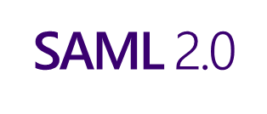


Azure Active Directory B2C
任何 SAML 提供程序
社交 ID
Microsoft Azure Active Directory
分析
企业和政府 ID
应用
contoso
用户
业务
使用首选标识提供程序安全地对客户进行身份验证
采集客户的登录、偏好和转换数据
提供品牌（白标）注册和登录体验
Notes:
Azure AD Business to Customer (B2C) enables an organization to provide customer-facing apps that enable users to sign with an identity they already have, such as a Microsoft Account, Gmail, Facebook, or Twitter account or create an account for the solution.​

Slide 11
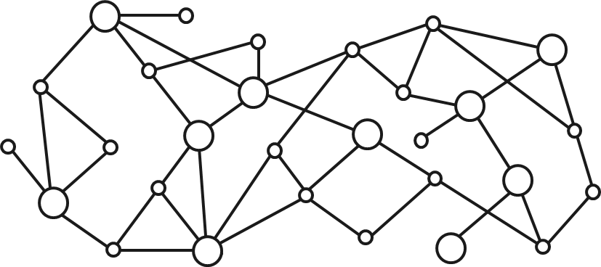
通往 Microsoft 云中数据的通道
你的应用
Web App
设备和本地应用
机器人
后台流程
1
网关
Microsoft Graph
Office 365
Windows 10
企业移动性 + 安全性
你或你的 客户的数据
Microsoft 身份
丰富的内容
深刻见解
实时更新
Notes:
Microsoft Graph is the gateway to all your data in the Microsoft Cloud. From Office 365, Enterprise Mobility + Security to Windows 10, Microsoft Graph enables developers to build applications that provide users access to their data. Developers and users can access their data with Microsoft Graph by authenticating and authorizing users with Microsoft identity.

Slide 12


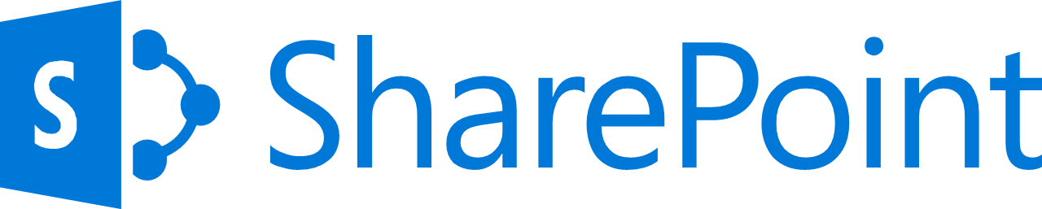
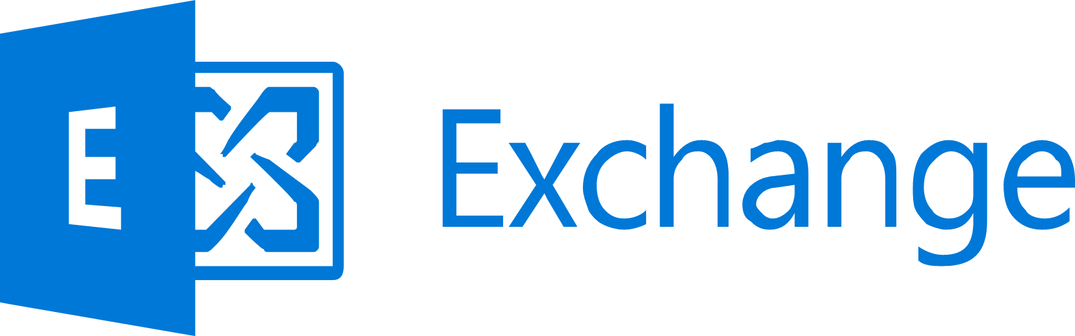




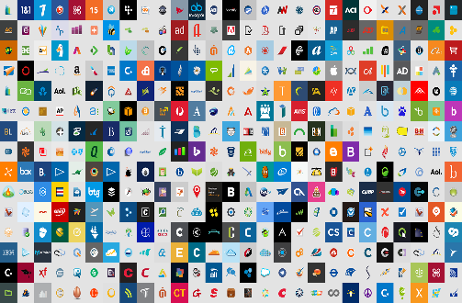


控制
Azure AD
场景
ADFS
MSA
40TB
Google ID
Microsoft Cloud
员工和合作伙伴用户和角色
允许/阻止
访问
会话 风险
Android
机器 学习
Microsoft Cloud App Security
iOS
3
有限
访问
MacOS
受信任和合规的 设备
Windows
Windows Defender ATP
需要
MFA
云 SaaS 应用
实时评估 引擎
地理位置
实际和虚拟位置
强制
密码
重置
公司网络
******
策略
有效 策略
客户端应用和身份验证方法
浏览器应用
阻止旧式身份验证
客户端应用
本地应用
Notes:
The third element of Microsoft identity is policies. Policies have become complicated with users accessing resources from different networks and devices. The threat matrix depending on how a user is accessing a resource is complex. Various combinations of different users using different devices pose different risks to the organization.
Microsoft identity is built to support this complex and dynamic threat matrix. One policy can be applied when a user is on a trusted corporate network using their company issued laptop, while another policy can apply to the same user when they access the same resource from home on their personal tablet.
By relaying on Microsoft identity to handle these complex policies, you don't have to implement the complex logic in your custom applications.

Slide 13
支持的帐户类型和拓扑
Microsoft 身份平台可以使用以下身份登录用户：
工作或学校帐户 (Azure AD)
个人帐户（Microsoft 帐户，如 Skype、Xbox、Outlook.com）
社交或本地帐户
单租户应用仅登录组织租户的用户
多租户应用登录多个组织的用户：
在任何 Azure AD 目录中
在任何 Azure AD 目录 + 个人 Microsoft 帐户中
Azure Active Directory B2C (Azure AD B2C)
Microsoft 身份平台支持以下身份拓扑：
消费者
企业
企业到企业 (B2B)
企业到客户 (B2C)
Notes:
A key decision you will make when registering the app is what type of accounts will it support? The Microsoft identity platform supports the following types of accounts:
- single organization
- multiple organization
- personal Microsoft accounts
In any Azure AD directory: All users and guests with a work or school account from Microsoft can use your application or API. This includes schools and businesses that use Office 365. You should use this option if your target audience is business or educational customers.
In any Azure AD directory + personal Microsoft accounts: All users with a work or school, or personal Microsoft account can use your application or API. It includes schools and businesses that use Office 365 as well as personal accounts that are used to sign in to services like Xbox and Skype. Use this option to target the widest set of Microsoft accounts.
If you're writing a business-to-consumer application, you can also sign in users with their social identities, by using Azure Active Directory B2C (Azure AD B2C)

Slide 14
Microsoft 身份中的令牌类型
Notes:
As a developer, when you build an application, you will ultimately request tokens from Microsoft identity to identify a user and authorize them to use an application with specific permissions. Let's look at the different tokens you will use.

Slide 15
OpenID Connect 和 ID 令牌
Open ID Connect 扩展了 OAuth 2.0
使用 OAuth 2.0 的授权协议作为身份验证协议
帮助开发人员使用 OAuth 实现单点登录
ID 令牌
客户端可用于验证用户身份的安全令牌
包含有关用户的基本配置文件信息
ID 令牌中的声明可用于用户体验、DB 中的密钥以及提供对客户端应用的访问
Notes:
The first type of token is an ID token that is made available via Microsoft identity's support of the OpenID Connect protocol.
OpenID Connect extends the OAuth 2.0 authorization protocol to use as an authentication protocol, so that you can implement single sign-on using OAuth in your applications. It also introduces the concept of an ID token.
An ID token is a security token that allows the client to verify the identity of the user. The ID token also gets basic profile information about the user. Because OpenID Connect extends OAuth 2.0, apps can securely acquire access tokens, which can be used to access resources that are secured by an authorization server.
The claims included within an ID token can be used for the user experience within your application, as keys in a database, and providing access to the client application.
ID tokens for Microsoft identity are JSON web tokens (JWT). These ID tokens consist of a header, payload, and signature. The header and signature are used to verify the authenticity of the token, while the payload contains the information about the user requested by your client.

Slide 16
访问令牌
ID 令牌用于识别用户
访问令牌用来代表用户授权对应用的 API 进行一系列的操作
Notes:
*Access tokens* enable clients to securely call APIs protected by Azure AD. Applications should never inspect or validate an access token. Access tokens must only be passed to the API.
Access tokens are created based for the audience of the token, meaning the API that owns the scopes in the token. ​

Slide 17
用户访问令牌和应用访问令牌之间的区别
应用可以代表用户...
直接接收来自
…应用（例如：守护进程或服务应用）的令牌
仅应用令牌表示请求来自于一个应用，没有用户的支持
Notes:
Your application may receive tokens on behalf of a user or directly from an application as if there is an automated service or daemon application.
These app-only tokens indicate that this call is coming from an application and doesn't have a user backing it. These tokens are handled largely the same as user tokens, with some differences.

Slide 18
注册应用

Slide 19
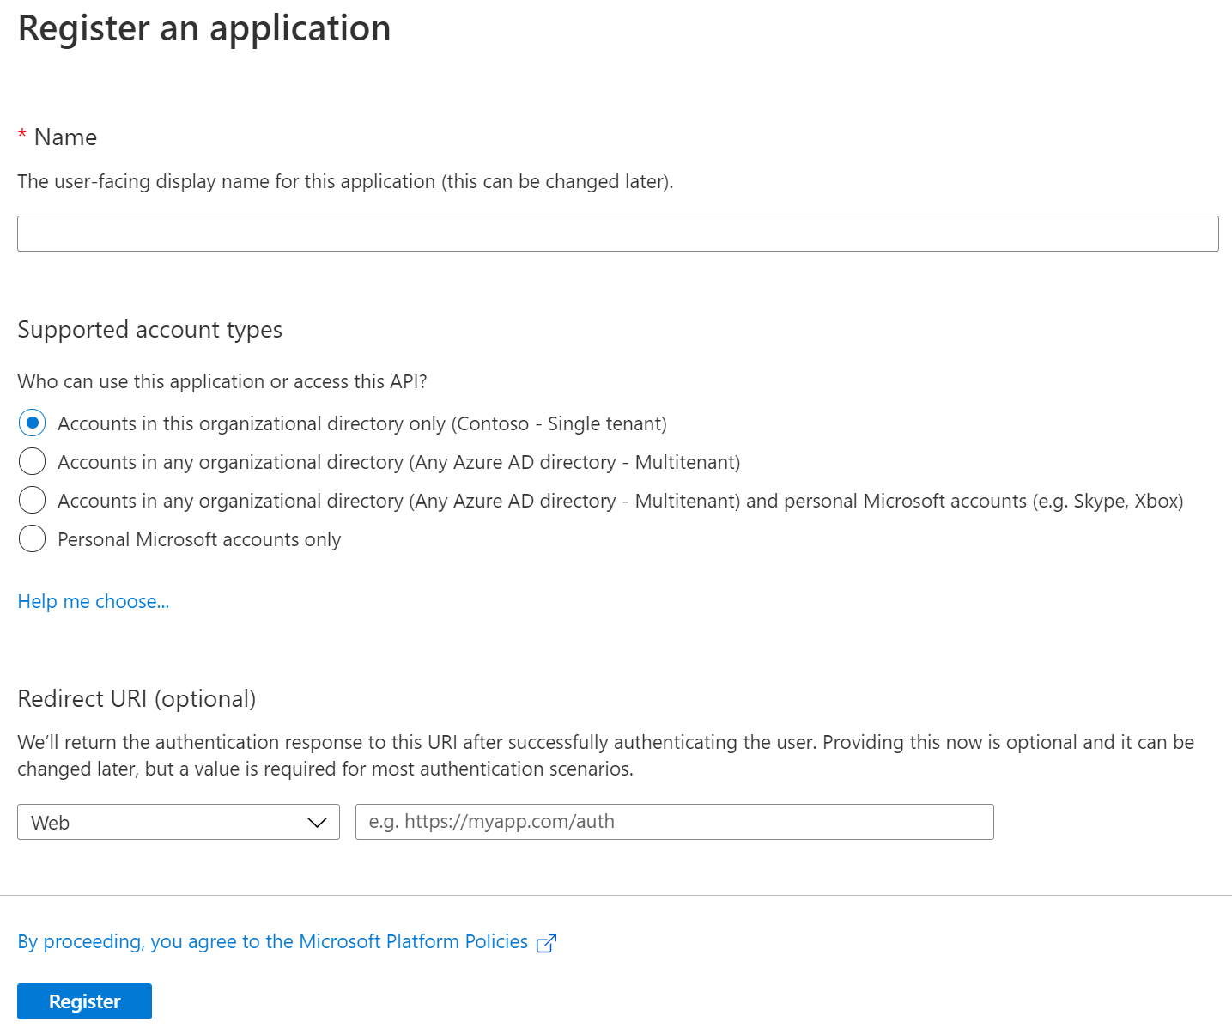
注册应用
注册字段：
应用名称
支持的帐户类型
重定向 URI（可选）
应用清单：
应用注册 > 清单
Notes:
The Azure AD application is the control point for how you access the identity and the information it protects. For an identity provider to know that a user has access to a particular app, both the user and the application must be registered with the identity provider.
When you register your application with Azure AD, you are providing an identity configuration for your application that allows it to integrate with Azure AD.
Once registered, the application will be given a GUID that the app shares with Azure AD when it requests tokens. When you register an app, you will be provided with code snippets to add to your web application's web.config file. These snippets are how Microsoft identity will recognize your app.
The manifest gets created automatically by the Microsoft identity platform during the app registration process (when you click Register). The **application manifest** contains a definition of all the attributes of an application object in the Microsoft identity platform. It also serves as a mechanism for updating the application object. The manifest is where you can record additional metadata for your application. The metadata includes things such as a link to a logo image, Terms of Use, and a privacy statement, as well as defining group membership, role definitions, and permissions.
Scenarios where you'll need to edit the app manifest to configure an app's attribute. These scenarios include:
- If you registered the app as Azure AD multi-tenant and personal Microsoft accounts, you can't change the supported Microsoft accounts in the UI. Instead, you must use the application manifest editor to change the supported account type.
- If you need to define permissions and roles that your app supports, you must modify the application manifest.

Slide 20
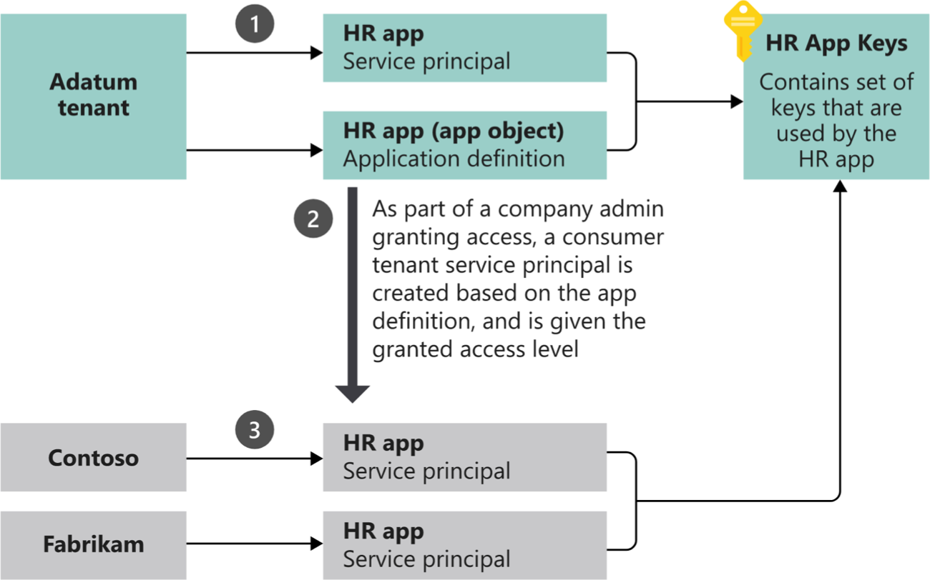
应用模型概述
应用对象：
存储在清单中的应用属性
定义所需的应用权限
服务主体对象：
用于在非主租户中定义应用权限的应用对象副本
Notes:
Consider the application object as the global representation of your application for use across all tenants, and the service principal as the local representation for use in a specific tenant.
A service principal must be created in each tenant where the application is used, enabling it to establish an identity for sign-in and/or access to resources being secured by the tenant. A single-tenant application has only one service principal (in its home tenant), created and consented for use during application registration. A multi-tenant Web application/API also has a service principal created in each tenant where a user from that tenant has consented to its use.
In this example scenario:, there are 3 high-level steps related to the creation of the application object and each service principal:
1-Both the application object and a service principal are created in the application's home tenant (the Adatum tenant).
2-When Contoso and Fabrikam administrators complete consent, a service principal object is created in their company's Azure AD tenant and assigned the permissions that the administrator granted. Also note that the HR app could be configured/designed to allow consent by users for individual use.
3-The consumer tenants of the HR application (Contoso and Fabrikam) each have their own service principal object. Each represents their use of an instance of the application at runtime, governed by the permissions consented by the respective administrator.

Slide 21
实施身份验证
单页应用
登录用户和调用 API 的 Web 应用
守护进程和非交互式应用
Notes:
In this section, you’ll learn how you can implement different OAuth 2.0 protocol grant types (flows) in popular application types.

Slide 22
单页应用

Slide 23
单页应用
现代 Web 应用可以完全使用 JavaScript 在客户端构建
（可选）利用 Web 框架（React、Angular、Vue 等）
完全在 Web 浏览器中运行 – 没有（或最低限度的）服务器端组件
Notes:
Web standards and modern browsers have advanced considerably in recent years to the point that developers can create sophisticated client-side applications. These client-side applications, also referred to as single-page applications (SPAs), can enable users to authenticate and obtain tokens from Microsoft identity platform that can be used to call secured web APIs.
Many modern web applications are built as client-side SPAs written using JavaScript or a SPA framework such as Angular, Vue, or React. These applications have traditionally used the OAuth 2.0 implicit flow to authenticate and obtain an access token to connect to protected services.

Slide 24
OAuth 2.0 的隐含流程和授权代码流程
Microsoft 身份平台同时支持隐式流程和授权代码流程，但建议使用授权代码流程。
隐式流程使用 iframe 和 Cookie 进行静默单点登录。 许多现代浏览器会阻止第三方 Cookie
隐式流程会公开访问令牌
授权代码流程解决了这些问题
Notes:
The pattern used to implement the implicit flow in SPAs included the use of iframes and cookies for silent single sign-on in the browser. However, many modern browsers now block third-party cookies which breaks that implementation. That fact, along with concerns about the visibility of access tokens when using the implicit grant flow, lead to the decision to move to using the OAuth 2.0 authorization code flow for SPAs.

Slide 25
Microsoft 认证库 (MSAL) JS
如果想要使用 Microsoft 身份进行身份验证和获取访问令牌，以授权对 SPA 中安全端点的请求，最简单方法是使用针对 JavaScript 的 Microsoft 认证库 (MSAL) 。
MSAL.js 1.x 只支持使用隐式流程
MSAL.js 2.0（2020 年 7 月发布）支持使用授权代码流
Notes:
The easiest way to use Microsoft identity for authentication and to obtain access tokens to authorize requests to secured endpoints in SPAs is to use the Microsoft Authentication Library (MSAL) for JavaScript.
MSAL.js 1.x only supports the use of the implicit flow. However, in July 2020 Microsoft released MSAL.js 2.0 that supports the use of the authorization code flow. The remainder of this unit and the following exercise focus on MSAL.js 2.x and the use of the authorization code flow.

Slide 26
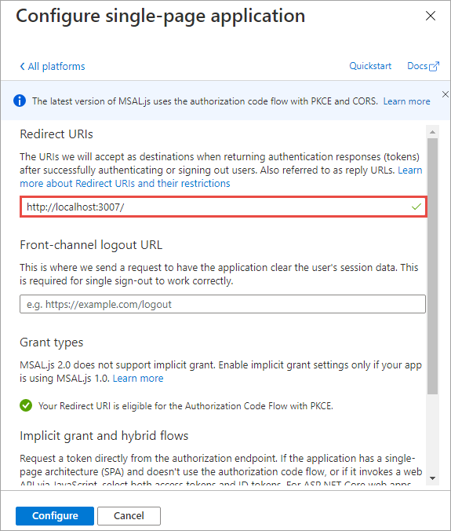
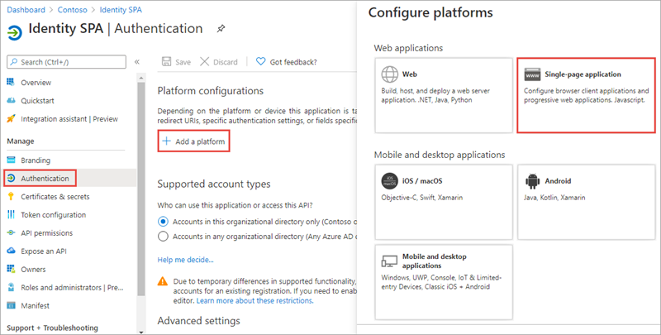
Azure AD 应用注册
SPA 必须有一个关联的 Azure AD 应用注册，以支持用户登录并获取访问令牌。
Notes:
In order for a SPA to use Microsoft identity to enable users to authenticate and obtain access tokens for use with services such as Microsoft Graph, you must register a new app with Azure AD. You can do this using the Azure AD admin center https://aad.portal.azure.com.
After the application has been created, configure it to use the Single-page application platform.
Next, ensure the redirect URI of the app points to the URL of the SPA. This URL must match the redirect URL provided by the SPA when the authentication process is initiated.

Slide 27
演示
实施身份验证
单页应用
Notes:
See the file M01_Manage roles and create teams.docx for instructions for this demonstration.​
​Demonstrations references in this deck utilize a Microsoft 365 E5 tenant and access to Microsoft Teams.
Set up instructions -Set up can take up to 60min
https://microsoft.sharepoint.com/:w:/t/FY20BaselineLocalEventsPlanning/ERs4HL_d3RNFiwERCPC3mGMBkKo0lIjdgJb_r78bpJYWyg?e=wIQtUi
​

Slide 28
登录用户和调用 API 的 Web 应用

Slide 29
登录用户和调用 API 的 Web 应用
添加身份验证，使 Web 应用能够访问有限的个人资料详细信息
姓名、电子邮件、唯一 ID
用户在浏览器中进行身份验证
Web 应用将用户重定向到 Microsoft 身份进行登录
Microsoft 身份将用户重定向到 Web 应用，并在身份令牌中对用户提出要求
Web 应用也可以从 Microsoft 身份中获得访问令牌，以代表用户行事。
Notes:
Adding authentication enables your web app to access limited profile information and customize the experience offered to users.
Web apps authenticate a user in a web browser.
In this scenario, the web application directs the user to sign into Microsoft identity. Microsoft identity returns a sign-in response through the user’s browser, which contains claims about the user in a identity token.
As a second phase you can also enable your application to call web APIs on behalf of the signed-in user.

Slide 30
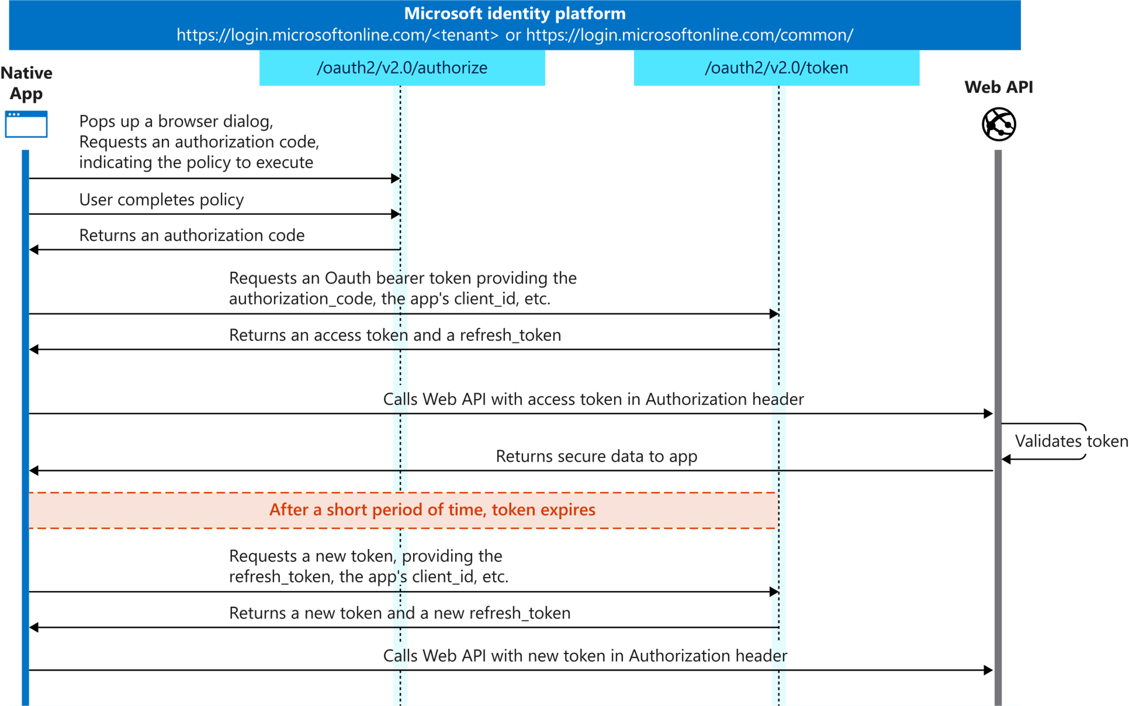
OAuth 2.0 授权代码授予流程
Notes:
The OAuth 2.0 authorization code grant flow is common when websites or custom applications leverage Azure AD as a federated authentication provider. When the application needs a user to sign in, or needs an access token to act on their behalf, it redirects the user over to Azure AD’s authorization endpoint to authenticate. The user signs in using their email and password and in turn Azure AD redirects the user upon a successful sign-in back to a specific URL in the app.
When Azure AD redirects the user back to the web app, it includes an authorization code. The authorization code is an encoded string that only Azure AD can read. The web app takes this authorization code, which is valid for a short time, and includes it in a request to the Azure AD token endpoint.
In addition to the authorization code, the request to the token endpoint includes a `grant_type` parameter that tells the endpoint it's exchanging the authorization code to obtain the access token on your behalf.
A benefit of this grant flow is that the web app never sees your username and password. All authentication happens over on Azure AD and the application just gets the authorization code that’s a result of the sign-in process. This aspect to the auth code grant flow makes it very secure.

Slide 31
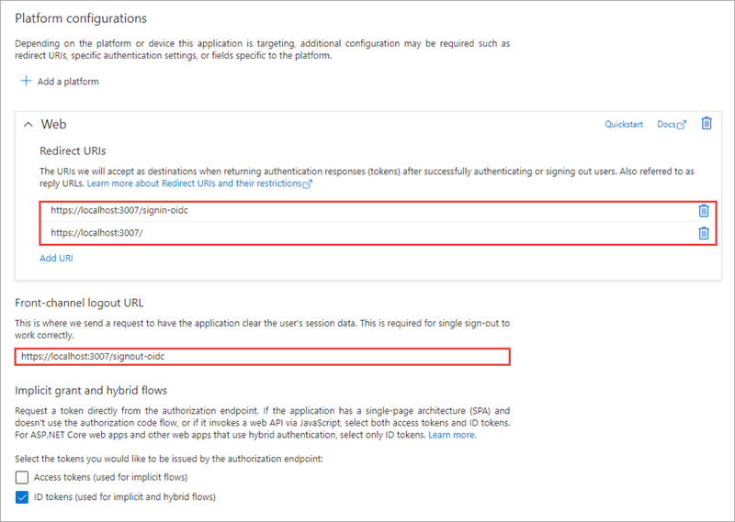
Azure AD 应用注册
Web 应用必须有一个关联的 Azure AD 应用注册，以支持用户登录并获取访问令牌。
确保设置了重定向 URI 和注销 URL
Web 应用也需要一个客户端密钥
当交换访问令牌的身份验证代码时，由应用用于身份验证。
创建应用后，复制 3 个值用于 MSAL 和代码配置
租户 ID
客户端 ID
客户端密钥/证书（生产应用）
Notes:
In order for a web app to use Microsoft identity to enable users to authenticate and obtain access tokens for use with services such as Microsoft Graph, you must register a new app with Azure AD. This can be done using the Azure AD admin center https://aad.portal.azure.com.
When registering the app in Azure AD, ensure the redirect URI of the app points to the callback URL of the web app. This URL must match the redirect URL provided by the app when the authentication process is started. The authorization code will be sent to this endpoint, which means you need to configure any authentication libraries and/or middleware to listen on this endpoint to receive the authorization code.
A sign-out URL should also be specified so the authentication libraries and/or middleware deletes any cached tokens or other data that are only needed for signed in users.
The web app will also need a client secret to sign in with Azure AD to exchange the authorization code for an access token.
There are three things you'll need from the Azure AD app registration:
- **Tenant ID**: ID of your Azure AD directory
- **Client ID**: unique auto-generated ID of the app (*this is also referred to as the application ID*)
- **Client secret**: secret you created during app registration
> [!NOTE]
> While a secret key is used here for purposes of simplicity, Microsoft recommends production apps use certificates with the OAuth 2.0 authorization code grant flow.

Slide 32
登录和获取密钥
登录流程是通过将用户重定向到 Azure AD 登录页面进行处理的。
登录过程使用 appsettings.json 文件中的值和之前设置中定义的配置来创建 Azure AD URL，以便将用户发送至此。
当用户登录到 Azure AD 并重定向到 Web 应用时，Web 应用使用 MSAL.NET 库来获取访问令牌。
Notes:
The sign-in process is handled by redirecting the user to the Azure AD sign-in page. This is set by default for you when you create a new ASP.NET Core web application.
The sign-in process uses the values from the appsettings.json file and the configuration defined in the previous setup to create the Azure AD URL to send the user to. This URL specifies things like the Azure AD application's ID, the tenant ID, and the scopes required by the web application.
When a user signs-in to Azure AD and is redirected back to the web application, the web app uses the MSAL.NET library to obtain an access token. This is handled for you by the Microsoft.Identity.Web library.

Slide 33
守护进程和非交互式应用

Slide 34
守护进程和非交互式应用
一些应用需要进行身份验证并获得访问令牌，以便在没有任何用户互动的情况下调用安全端点
控制台应用
服务
需要访问服务的 Web 应用，但不是在当前用户的背景下 (Azure KeyVault)
这些类型的应用：
需要应用 权限，而不是委托 权限
必须由管理员批准其权限
是机密客户申请
拥有自己的身份验证凭证
Notes:
Your application can acquire a token to call a web API on behalf of itself (not on behalf of a user).
This scenario is typically used when an app needs an access token but doesn't want to work under the context of a user+app permissions. Instead, the app needs its own permissions to work independently of a user. These types of permissions are called *application permissions*.
Application permissions are common in service or daemon-related apps. The way this works is the application has its own credentials that are used to authenticate and obtain an access token from a token issuer.
Here are some examples of use cases for daemon apps:
web applications that are used to provision or administer users, or do batch processes in a directory
desktop applications (such as windows services on Windows, or daemons processes on Linux) that do batch jobs, or an operating system service running in the background
web APIs that need to manipulate directories, not specific users
Another common case where non-daemon applications use the client credentials flow is when they need elevated privileges that a user doesn't have. For example, even when apps act on behalf of users, they need to access a web API or a resource with their identity and not the user's identity, such as accessing secrets in Azure KeyVault or an Azure SQL database for a cache.
Applications that acquire a token for their own identities:
Are confidential client applications. These apps, given that they access resources independently of a user, need to prove their identity. They're also rather sensitive apps, which they need to be approved by the Azure Active Directory (Azure AD) tenant admins.
Have registered a secret (application password or certificate) with Azure AD. This secret is passed-in during the call to Azure AD to get a token.

Slide 35
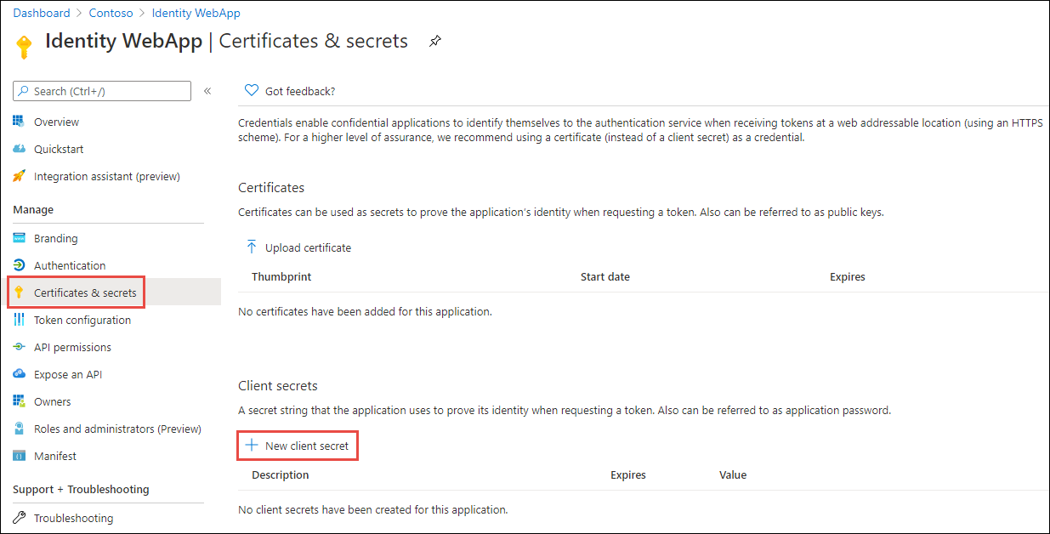
Azure AD 应用注册
对于利用客户凭据流的应用，不需要重新定向 URI。
必须上传证书或为应用创建一个客户密钥
Notes:
In order for a service or daemon app to use Microsoft identity to enable users to authenticate and obtain access tokens for use with services such as Microsoft Graph, you must register a new app with Azure AD. This can be done using the Azure AD admin center https://aad.portal.azure.com.
Unlike the previous application types discussed, you don't need to specify a redirect URI or sign out URI.
In addition, you don't need to enable the ID token or access token for the implicit grant flow; these don't apply to the client credentials grant flow.
One unique aspect to apps that use the client credentials grant flow is that their permissions must be defined ahead of time, also referred to as static permissions.

Slide 36
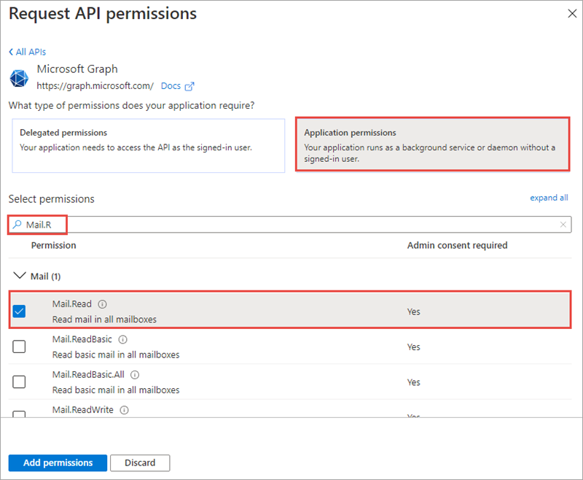
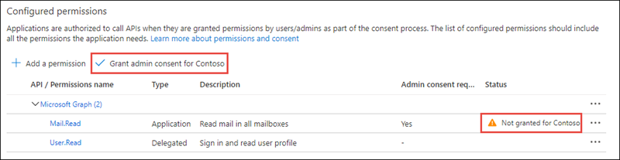
权限
守护进程应用只能向 API 请求应用权限
必须在 Azure AD 中把应用所需的所有权限定义为应用 权限
权限必须有租户管理员对调用网络 API 的应用的预先同意
Notes:
Daemon application can only request application permissions to APIs (not delegated permissions). Application permissions are defined on the API Permission page for the application registration.
Daemon applications require have a tenant admin pre-consent to the application calling the web API. This consent is provided in the same API Permission page.

Slide 37
权限和同意框架
了解 Microsoft 身份平台中的权限和同意框架
委托权限和同意
应用权限和同意
Notes:
The Microsoft identity platform implements the OAuth 2.0 authorization protocol. This protocol is a method that a third-party app can access web-hosted resources on behalf of a user. The web-hosted resources can define a set of permissions that you can use to implement functionality in smaller chunks. Developers can leverage one of two types of permissions supported by the Microsoft identity platform depending on the app scenario.
In this section, you'll learn the different types of permissions and consent framework models for obtaining permissions from users to use them in apps.

Slide 38
了解 Microsoft 身份平台中的权限和同意框架

Slide 39
权限类型
委托权限
由有登录用户存在的应用使用
用户提供给应用的权限，以便应用能够代表用户行事。
不给应用提供权限
用户必须拥有其授予应用的权限
应用权限
由在没有登录用户时运行的应用使用
有效权限
应用在向目标资源发出请求时拥有的权限
委托权限和应用权限的交集
Notes:
Microsoft identity platform supports two types of permissions: delegated permissions and application permissions.
Delegated permissions are used by apps that have a signed-in user present. These permissions are provided to the application by the user so the app can perform actions on their behalf. This doesn't give permissions to the app, instead the user is simply allowing the app to act on their behalf using their permissions.
Application permissions, are used by apps that run without a signed-in user present.
We will explore both delegated and application permissions in depth.
Effective permissions are the permissions that your app will have when making requests to the target resource. It's important to understand the difference between the delegated and application permissions that your app is granted and its effective permissions when making calls to the target resource.

Slide 40
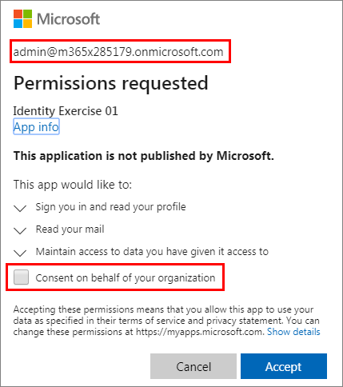
请求整个租户的许可
通常，当一个组织购买一个应用的许可证或订阅时，该组织希望主动对该应用进行设置，以供该组织的所有成员使用。
HTTP
GET https://login.microsoftonline.com/{tenant}/v2.0/adminconsent? client_id=6731de76-14a6-49ae-97bc-6eba6914391e &redirect_uri=http://localhost/myapp/permissions &scope=https://graph.microsoft.com/calendars.read%20https://graph.microsoft.com/mail.send &state=12345
Notes:
Often, when an organization purchases a license or subscription for an application, the organization wants to proactively set up the application for use by all members of the organization. As part of this process, an administrator can grant consent for the application to act on behalf of any user in the tenant. If the admin grants consent for the entire tenant, the organization's users won't see a consent page for the application.
To request consent for delegated permissions for all users in a tenant, your app can use the admin consent endpoint

Slide 41
申请权限的最佳做法
只要求实现功能所需的权限
切勿要求用户同意你在应用中没有实施的权限
始终申请需要最少特权的访问
如果一个应用需要 Mail.Read，就不要请求 Mail.ReadWrite
应用应妥善处理用户在请求权限时不同意应用的场景。
Notes:
When building an app that uses Azure AD to provide sign-in and access tokens for secured endpoints, there are a few good practices you should follow.
Only ask for the permissions required for implemented app functionality. Don't request user consent for permissions that you haven't yet implemented for your application.
In addition, when requesting permissions for app functionality, you should request the least-privileged access. For example, if an app analyzes a user's email but takes no action on the mailbox, you shouldn't request the more permissive **Mail.ReadWrite** when **Mail.Read** will work.
Apps should gracefully handle scenarios where the user doesn't grant consent to the app when permissions are requested. In the case where an app doesn't receive an access token with the required permissions, it should explain the situation to the user with options on how to remedy the issue.

Slide 42
演示
权限和同意框架
了解 Microsoft 身份平台中的权限和同意框架
Notes:
See the file M01_Manage roles and create teams.docx for instructions for this demonstration.​
​Demonstrations references in this deck utilize a Microsoft 365 E5 tenant and access to Microsoft Teams.
Set up instructions -Set up can take up to 60min
https://microsoft.sharepoint.com/:w:/t/FY20BaselineLocalEventsPlanning/ERs4HL_d3RNFiwERCPC3mGMBkKo0lIjdgJb_r78bpJYWyg?e=wIQtUi
​

Slide 43
委托权限和同意

Slide 44
委托权限
委托权限由有登录用户存在的应用使用
用户或管理员同意应用请求的权限
然后，应用被启用，以代表登录的用户行事
需要注意的是用户并没有授予应用权限；他们授予 应用代表他们行事的能力。
有些权限不能由用户授予，必须由管理员授予。
用户可授予的权限：User.Read & User.ReadBasic.All
管理员可授予的权限：User.Read.All
Notes:
Microsoft identity platform supports two types of permissions: delegated permissions and application permissions.
Delegated permissions are used by apps that have a signed-in user present. For these apps, either the user or an administrator consents to the permissions that the app requests, and the app is delegated permission to act as the signed-in user when making calls to the target resource. Some delegated permissions can be consented to by non-administrative users, but some higher-privileged permissions require administrator consent.
For example, a user can grant an app the delegated permissions **User.Read**, that enables the user of the app to sign in and read the user's profile, and **User.ReadBasic.All**, that allows the user of the app to read basic profile information about all users in the organization. Only an administrator can grant the **User.Read.All** permission that allows the user of the app to read the full profile information of all user's in the organization.

Slide 45
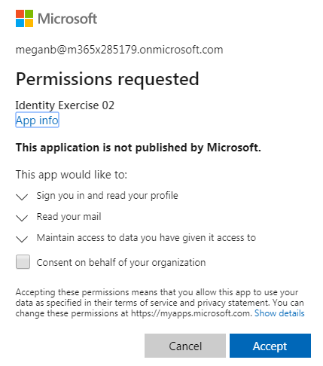
用户同意
如果用户/管理员在请求访问令牌时没有授予权限，用户会看到同意对话框
选择接受记录同意，用户就不会再看到有关权限的提示了
有两种方法可以申请驱动同意对话框中所列内容的权限：
静态同意
动态同意
Notes:
If the user has not previously granted the permission to the app or an administrator hasn't consented on behalf of all user's in the organization, when a user signs-in to an app they're prompted with the consent dialog.
When the user selects the **Accept** button, the consent settings are saved and the user won't be prompted again.
There are two ways to define the permissions an app needs that drives what permissions are listed in the consent dialog. These two approaches are called static and dynamic consent.

Slide 46
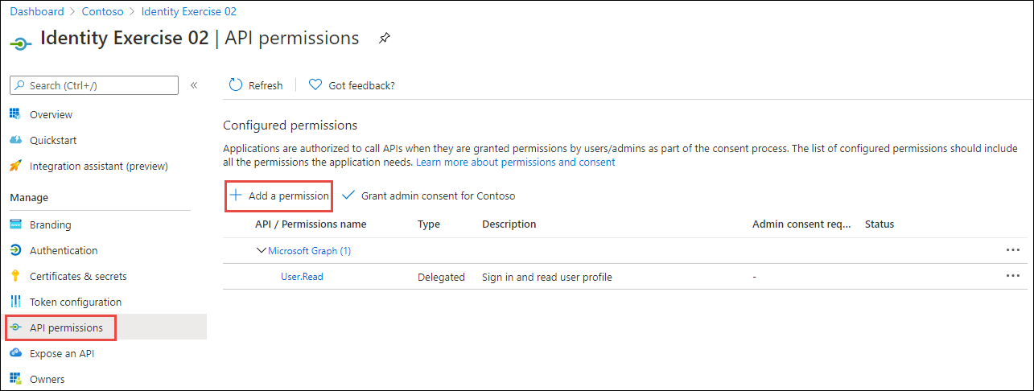
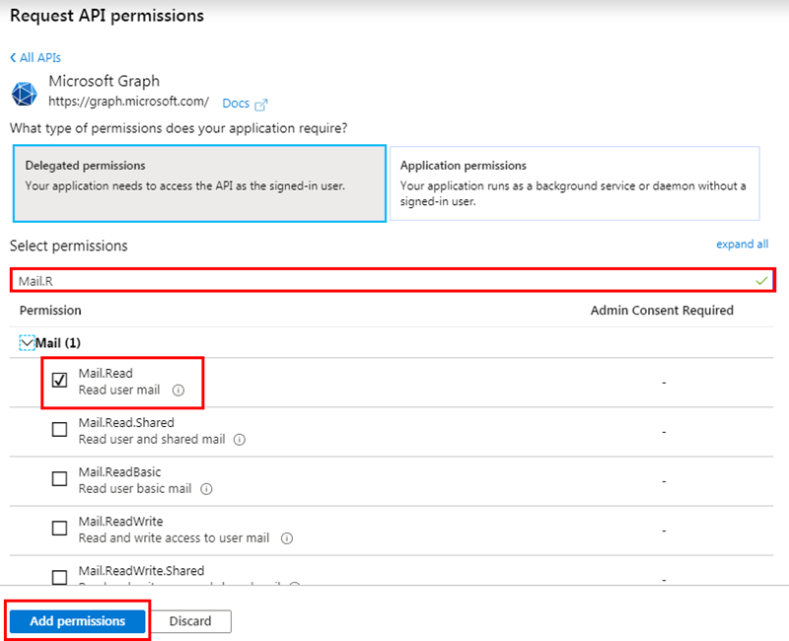
静态同意
在 Azure AD 管理中心内应用注册中定义的权限
使管理员能够代表组织中的所有用户表示同意
Notes:
With static consent, the permissions are defined in the app's registration within the Azure AD admin center.
The static consent approach is how the Microsoft identity v1.0 authorize endpoint worked. All permissions an application used needed to be defined ahead of time. When users signed in, they would have to consent to all permission requests.
This approach also enables administrators to consent on behalf of all users in the organization.

Slide 47
特殊 /.default 范围
在申请权限时，如果 /.default 范围代表在 Azure AD 管理中心内应用注册中定义的所有静态权限
已添加，以简化应用从 Microsoft 身份 v1.0 到 v2.0 端点迁移
将其纳入资源的末端。
[app id]/.default
/.default 范围必须用于实现 OAuth 2.0 客户端凭据流程的应用
Notes:
For developers migrating apps from the Microsoft identity v1.0 endpoint to the v2.0 endpoint, Microsoft introduced the `/.default` scope. This is a built-in scope for every application that refers to the static list of permissions configured on the application registration.
A scope value of **https://graph.microsoft.com/.default** is functionally the same as the v1.0 endpoints **resource=https://graph.microsoft.com**. This scope requests an access token with the scopes on Microsoft Graph that the application has registered for in the Azure portal.
The `/.default` scope should be used with apps that use the OAuth 2.0 client credentials flow.

Slide 48
动态同意
引入 Microsoft 身份 V2.0 的端点
权限不需要在 Azure AD 管理中心内的应用注册中指定（但强烈建议这样做）。
每次应用申请访问令牌时，在 scope 属性中指定其需要的权限
如果用户之前没有同意该权限，会提示他们接受该权限
使开发人员能够只要求用户提供应用当时所需的权限，并根据需要逐步要求更多的权限
Notes:
The other option to static consent is dynamic consent. This was introduced in the Microsoft identity v2.0 endpoint. With this option, permissions don't need to be specified in the app registration in the Azure AD admin center.
Each time the app requests an access token, it specifies the permissions it needs in the `scope` property. If the user hasn't already consented to those permissions, they'll go through the consent experience for the additional permissions.
Dynamic consent enables developers to only ask users for the permissions the app needs at that time. For example, at sign-in the app can request minimal profile information, but later request additional permissions to do more advanced tasks.

Slide 49
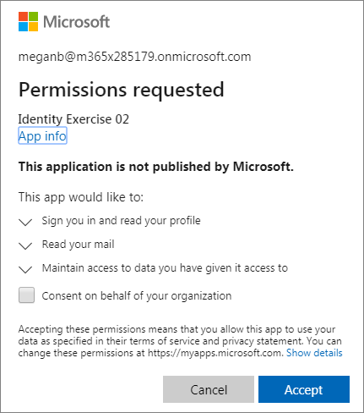
用户同意
如果用户之前没有授予该应用权限，或者管理员没有代表组织中的所有用户同意，当用户登录到一个应用时，他们会看到同意对话框提示。
Notes:
If the user has not previously granted the permission to the app or an administrator hasn't consented on behalf of all user's in the organization, when a user signs-in to an app they're prompted with the consent dialog.
When the user selects the Accept button, the consent settings are saved and the user won't be prompted again.
There are two ways to define the permissions an app needs that drives what permissions are listed in the consent dialog. These two approaches are called static and dynamic consent.

Slide 50
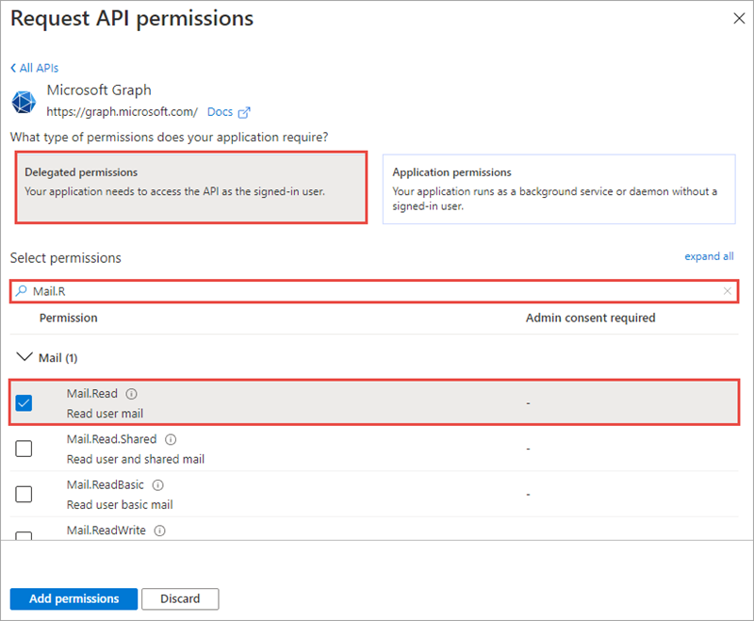
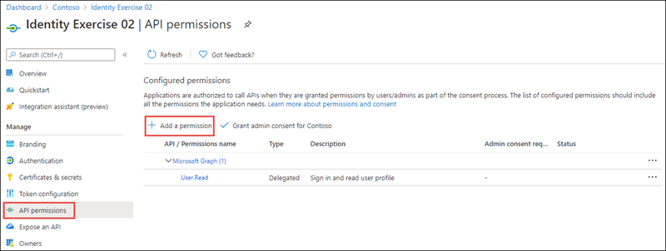
静态同意
在有静态同意的情况下，在 Azure AD 管理中心内的应用注册中定义权限。
Notes:
With static consent, the permissions are defined in the app's registration within the Azure AD admin center.
The static consent approach is how the Microsoft identity v1.0 authorize endpoint worked. All permissions an application used needed to be defined ahead of time. When users signed in, they would have to consent to all permission requests.
This approach also enables administrators to consent on behalf of all users in the organization.

Slide 51
应用权限和同意

Slide 52
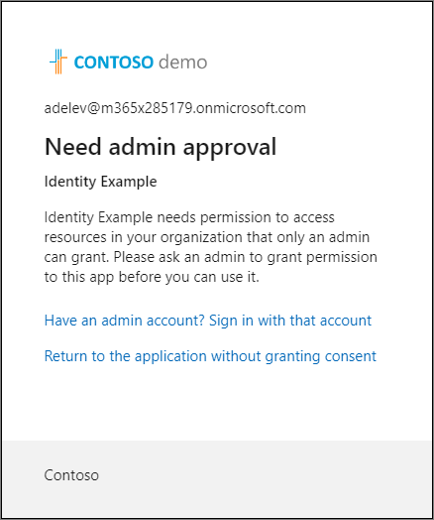
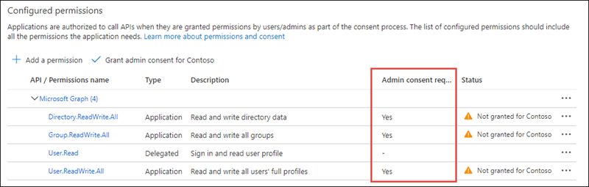
应用权限
在 Microsoft 生态系统中，一些高级权限可以设置为管理员限制。
通过使用 User.Read.All
来读取所有用户的完整资料。通过使用 Directory.ReadWrite.All。
将数据写入一个组织的目录中通过使用Group.Read.All 来读取一个组织目录中的所有组。
如果一个应用向用户请求一个应用权限，会通知用户需要管理员来授予该权限
Notes:
Some high-privilege permissions in the Microsoft ecosystem can be set to admin-restricted. Here are a few examples of these kinds of permissions:
Read all user's full profiles by using **User.Read.All**
Write data to an organization's directory by using **Directory.ReadWrite.All**
Read all groups in an organization's directory by using **Group.Read.All**
Although a consumer user might grant an application access to this kind of data, organizational users are restricted from granting access to the same set of sensitive company data. If your application requests access to one of these permissions from an organizational user, the user receives an error message that says they're not authorized to consent to your app's permissions.

Slide 53
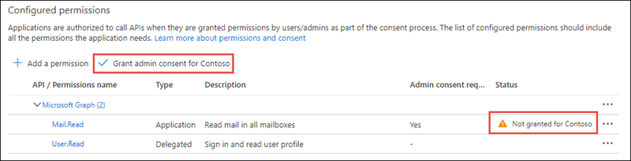
管理员许可
如果你想主动要求管理员代表整个租户授予权限，你也可以使用一个专门的管理员同意端点。
HTTP
GET https://login.microsoftonline.com/{tenant}/v2.0/adminconsent? client_id=6731de76-14a6-49ae-97bc-6eba6914391e &redirect_uri=http://localhost/myapp/permissions &scope=https://graph.microsoft.com/calendars.read%20https://graph.microsoft.com/mail.send &state=12345
Notes:
There's also a dedicated admin consent endpoint you can use if you would like to proactively request that an administrator grants permission on behalf of the entire tenant. Using this endpoint is also necessary for requesting Application Permissions (which can't be requested using the authorize endpoint).
This endpoint is also available by selecting the **Grant admin consent for ...** button from the Azure AD admin center:
If you follow these steps, your app can request permissions for all users in a tenant, including admin-restricted scopes. This is a high privilege operation and should only be done if necessary for your scenario.

Slide 54
建议：在你的应用中提供一个管理员体验
如果一个应用需要管理员同意才能拥有应用权限的高级委托权限，则考虑提供一个特殊的管理员体验来触发管理员同意。
减少应用培训问题
Notes:
When you build an application that uses the admin consent endpoint, the app should have an experience that enables the admin to approve the app's permissions. This page can be part of the app's sign-up flow, part of the app's settings, or it can be a dedicated "connect" flow. In many cases, it makes sense for the app to show this "connect" view only after a user has signed in with a work or school Microsoft account.
When you sign the user into your app, you can identify the organization to which the admin belongs before asking them to approve the necessary permissions. Although not strictly necessary, it can help you create a more intuitive experience for your organizational users. To sign the user in, follow our Microsoft identity platform protocol tutorials.

